Slide 1







Couplage d’approches d’observation fonctionnelle de la Baie de Seine
P. Claquin¹, L. Serre¹ O. Jolly ¹F. Jacqueline², M. Navon¹, L. Chasselin, G. Izabel, L. Quemener², D. Lemeille¹, JP Lehodey¹,, M. Repecaud²
email: pascal.claquin@unicaen.fr
¹BOREA (MNHN CNRS) - CREC – Station Marine Luc-Sur-Mer – Université de Caen Normandie
²IFREMER LERN & Centre de Brest
Thèse de Léon Serre- Fredj

Slide 2
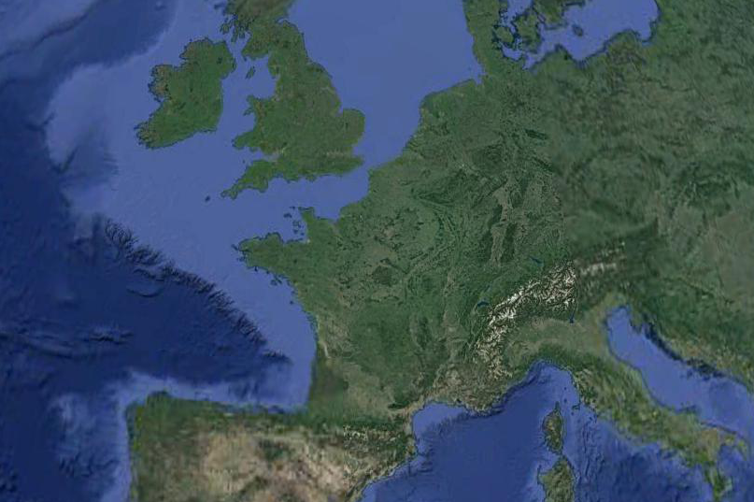
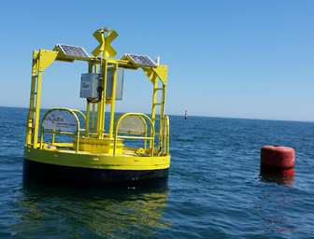


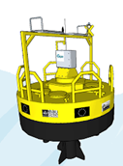

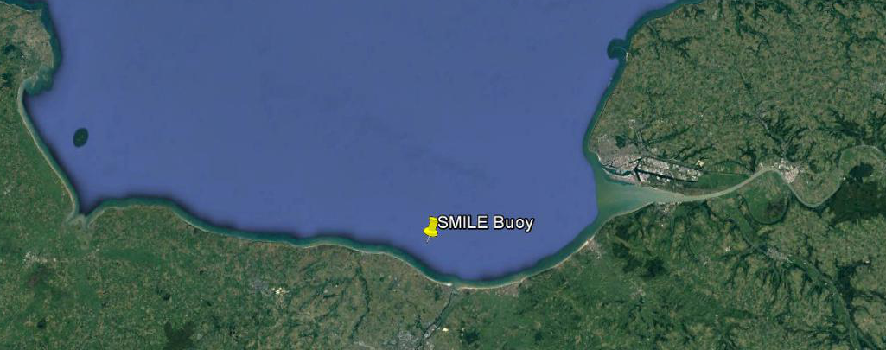

Site SMILE – Baie de Seine
(English Channel) since June 2016
Seine estuary
J. Fauchot / B. Leroy

Slide 3





Energy is supplied by
  - solar energy
  - waves and swell energy (GEPS techno)
  fuel cell (with methanol) is used as a backup.
Sub-surface measurements
-Temperature, salinity, dissolved O₂, turbidity, fluorescence (FFU), Meteorological parameters, PAR (every 20 min)
-Nutrients (OPUS sensor and WIZ sensor (when it works..))
- Fast Repetition Rate Fluorometer to estimate primary productivity
Depth measurements
Depth station
-Temperature, salinity, turbidity, fluorescence (FFU), ADCP
20 m depth max – Macrotidal system : tidal range 8 m

Slide 4
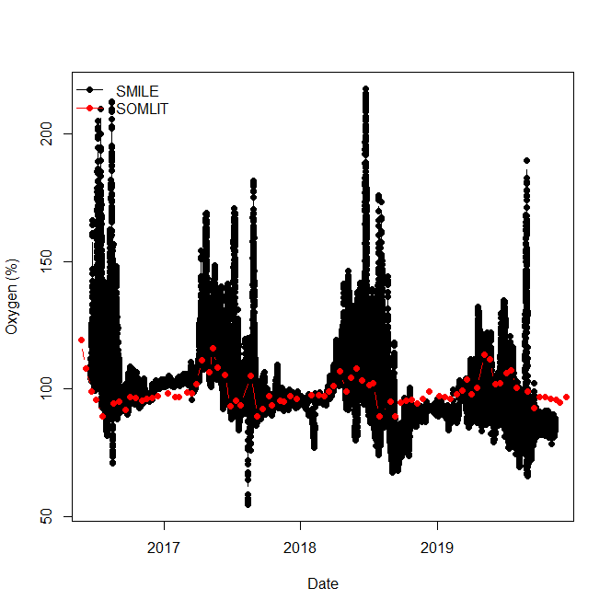

Slide 5
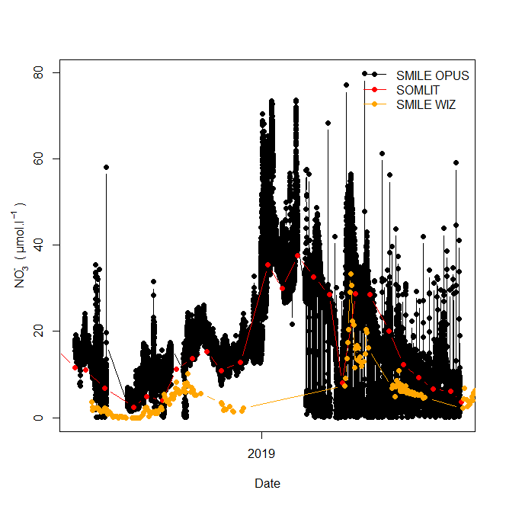
Capteur OPUS
Capteur WIZ

Slide 6
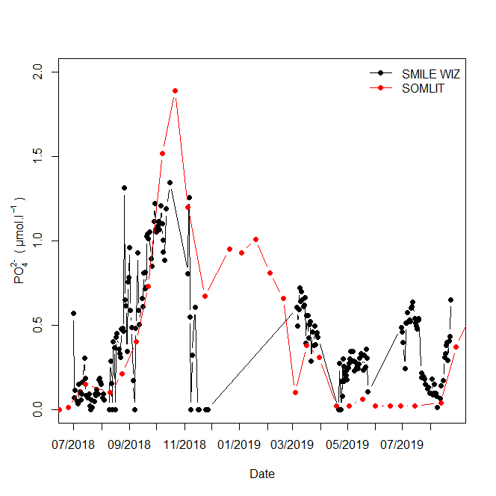

Slide 7
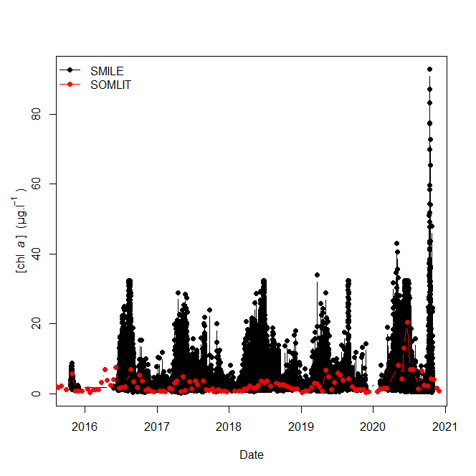

Slide 8
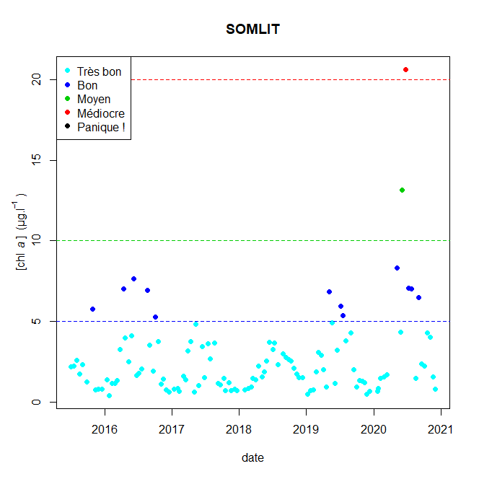
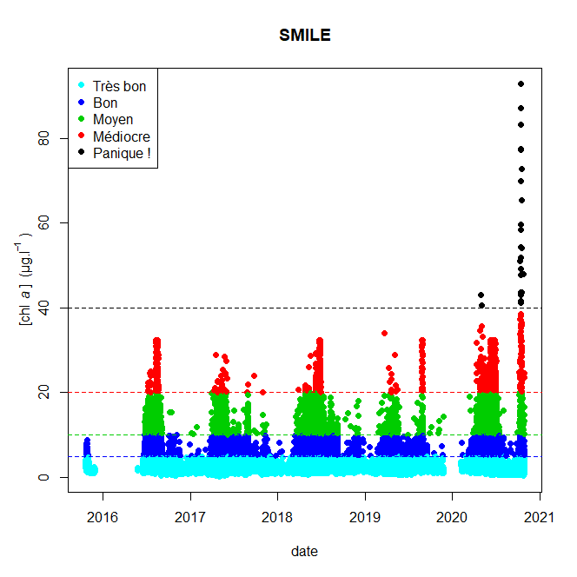
Indicateur DCE - Chla
Indicateur DCE - Chla

Slide 9
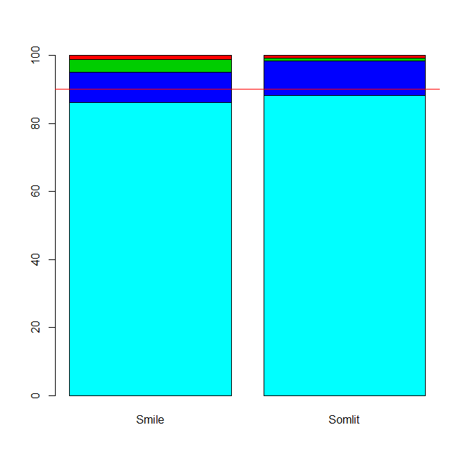
Application du percentile 90
Bon / très bon

Slide 10
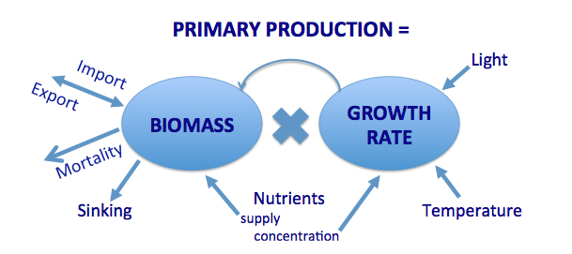
Biomasse = Stock – Image figée
Production = Flux de matière, énergie

Slide 11
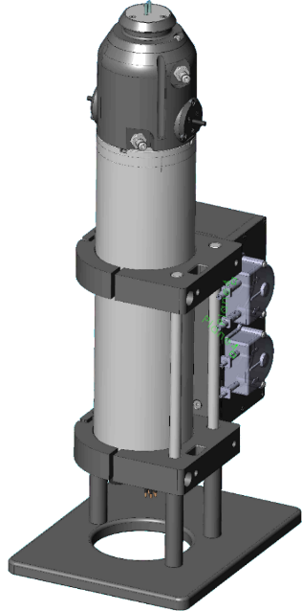
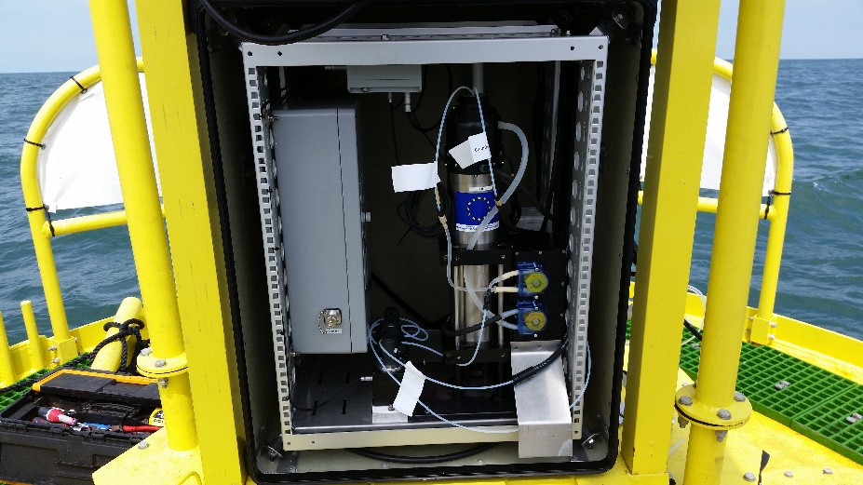

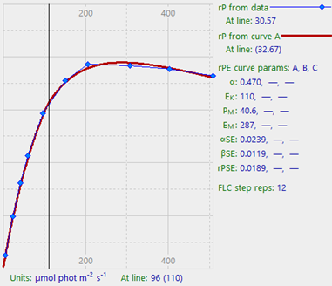
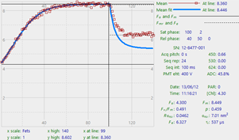
Estimation of phytoplankton primary productivity
Fast Repetition Rate Fluorometer (FRRF) Act2 Chelsea Technology, UK
Photosynthetic parameters
every 2 hours measurements are performed by using Fast Repetition Rate Fluorometer (FRRF) Act2 Chelsea Technology, UK - since March 2017.
Production / Energy curves
See Oxborough et al 2012 for details

Slide 12
Photosynthetic measurements
Production/ Energy curve
Production rate of electrons by the PSII as a function of light

Slide 13
Photosynthetic measurements
Production/ Energy curve
ETR_{max}
Maximal electron transport rate
The slope α
Maximal light utilization efficiency
Production rate of electrons by the PSII as a function of light

Slide 14
Maximal electrons transport rate for the year 2018 (Claquin et al. In prep) = Maximal photosynthetic capacity of the phytoplankton

Slide 15
Usually in literature : estimation of primary production is based on one set of data per week or per month –
Here, we have data every 2 hours
The photosynthetic capacity is highly variable during the day.

Slide 16


Photosynthetic measurements
Estimation of carbon fixation
¹³C
Carbon incorporation
Calvin cycle
Calvin cycle
Carbohydrates
H⁺
Fluorescence variation of the PSII
Production of electrons
ATP
ADP+P_{i}
Factor ?
NADP⁺
NADPH + H⁺
H⁺
ATPase
Fd
STROMA
PSII
e⁻
PSI
e⁻
LUMEN
H₂O
O₂ + H⁺
The relationship is not linear (Napoleon & Claquin, 2012; Morelle & Claquin, 2018)

Slide 17
Relationship between ETR(II) and carbon fixation on SMILE site as various seasons
Claquin et al, in prep.

Slide 18
Integration of the production as function of the depth
Daily primary production estimation (Claquin et al. In prep)

Slide 19
Integration of the production as function of the depth
(Claquin et al. In prep)
If we do the same estimation only with measurements performed at noon or only performed in the morning , the picture is not the same.
Because the maximal photosynthetic capacity change during the day.

Slide 20
Comparaison interannuelle en cours……
Et utilisation de ces outils pour décrire et comprendre des phénomènes à court terme
(Claquin et al. In prep)

Slide 21

Example of a bloom event – summer 2019
  - Serre et al 2021
Bloom of Lepidodinium chlorophorum (HAB species)

Slide 22
Example of a bloom event – summer 2019
  - Serre et al (2021)
Bloom of Lepidodinium chlorophorum (HAB species) due fresh water input

Slide 23
Example of a bloom event
  - Serre et al 2021
BLOOM
Bloom of Lepidodinium chlorophorum (HAB species) due fresh water input and nutrients inputs

Slide 24
Example of a bloom event
  - Serre et al “almost submitted”
Bloom of Lepidodinium chlorophorum (HAB species) due fresh water input and nutrients inputs

Slide 25
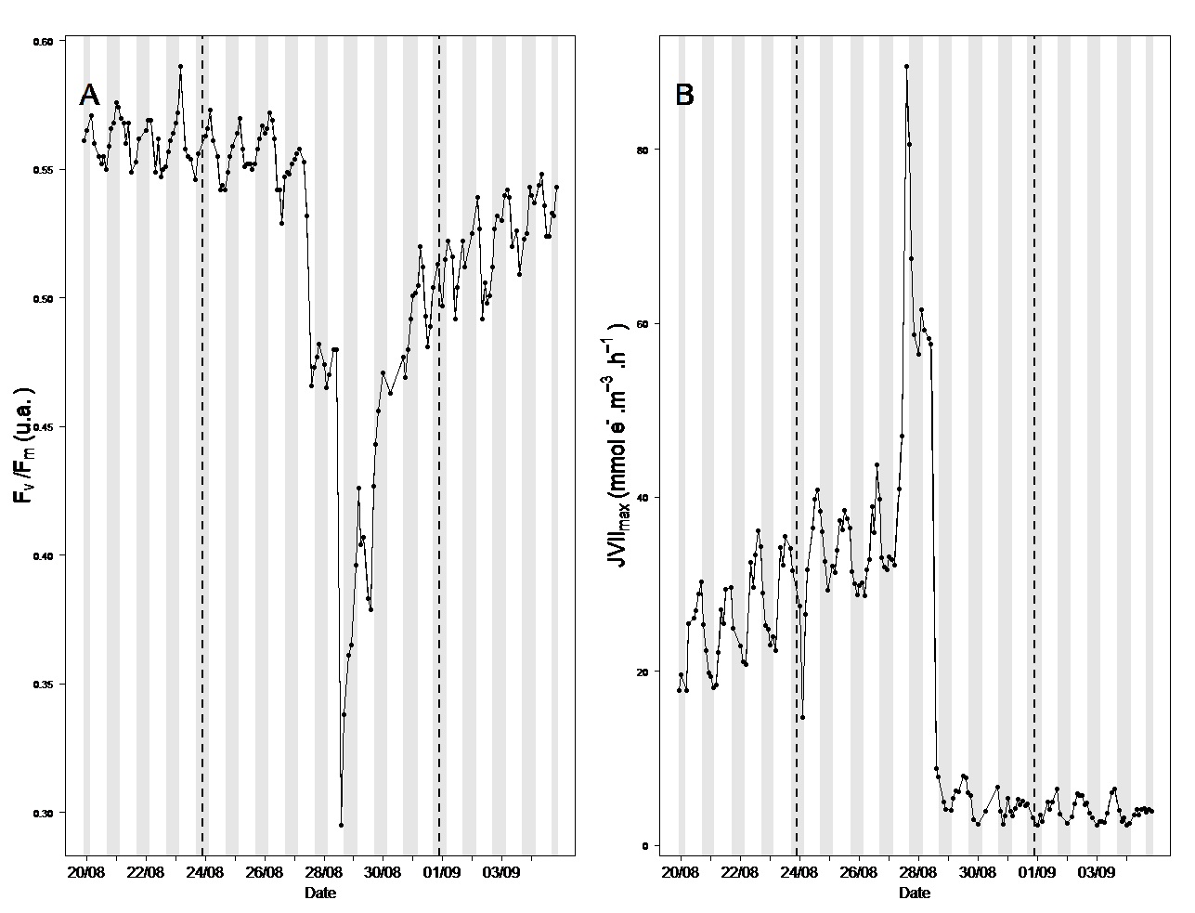
Example of a bloom event – summer 2019
  - Serre et al 2021
Crash of the bloom and of FRRF parameters

Slide 26
Example of a bloom event – summer 2019
  - Serre et al 2021
WIZ sensor
A drop of P concentration and an increase of N/P ratio are associated to the crash of the bloom
We showed that high frequency measurements of physicochemical biological, physiological parameters allow to detect the triggers of the bloom and its fate.

Slide 27
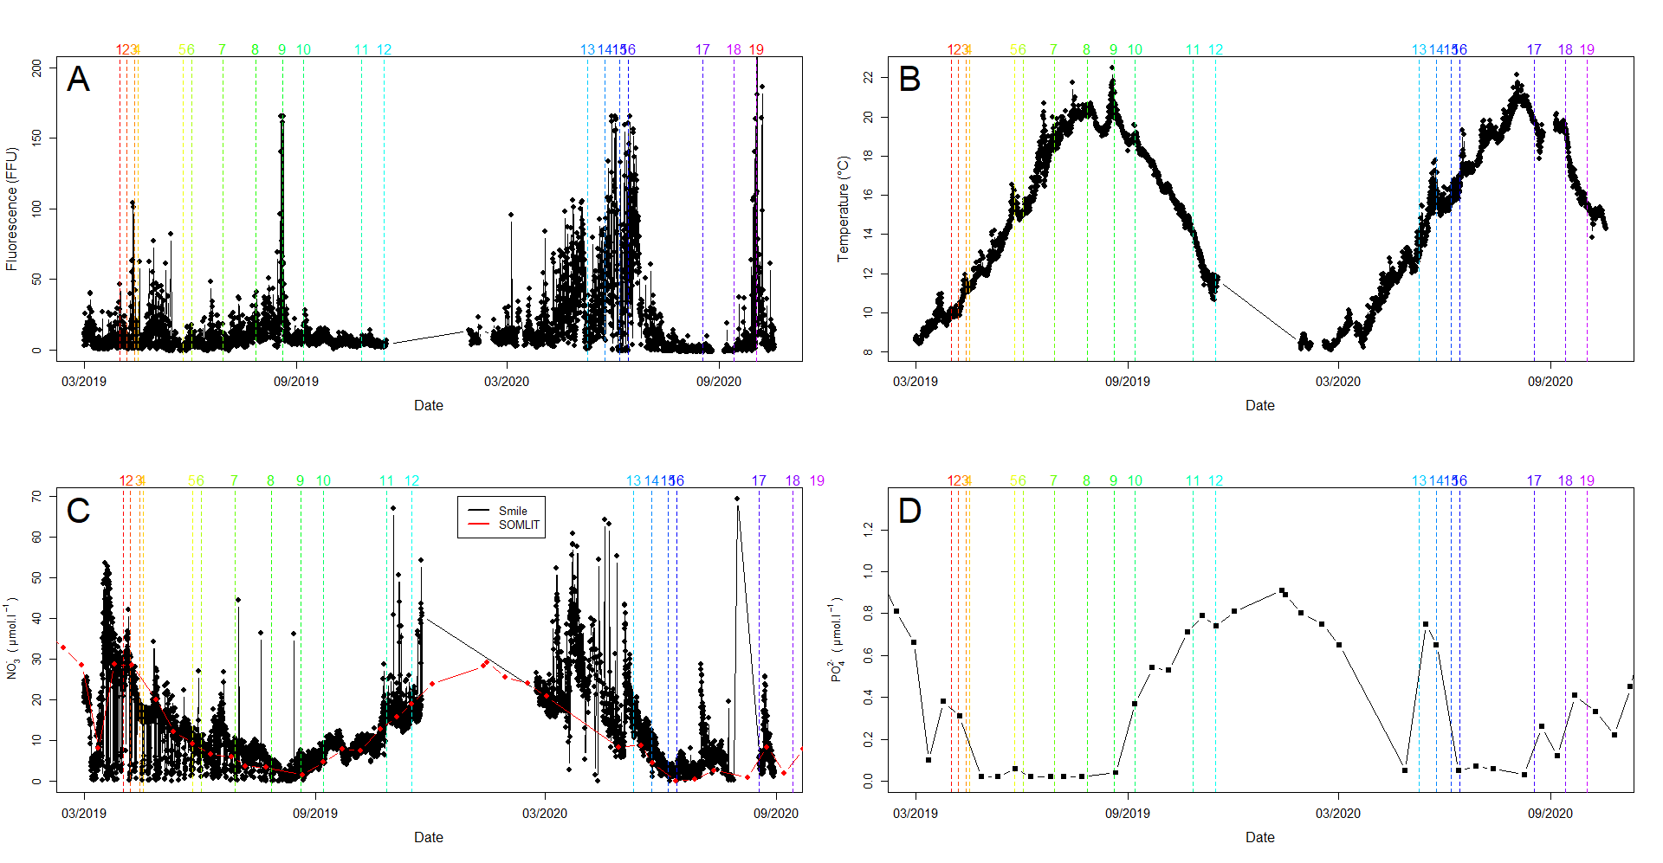
Serre et al soumis
Bioessais : Incubations d’échantillons avec différents apports de sels nutritifs pour comprendre la réponse de la communauté phytoplanctonique / la productivité / indicateurs physiologiques
Relations : diversité / fonctions et les impacts de la modification des apports en sels nutritifs

Slide 28
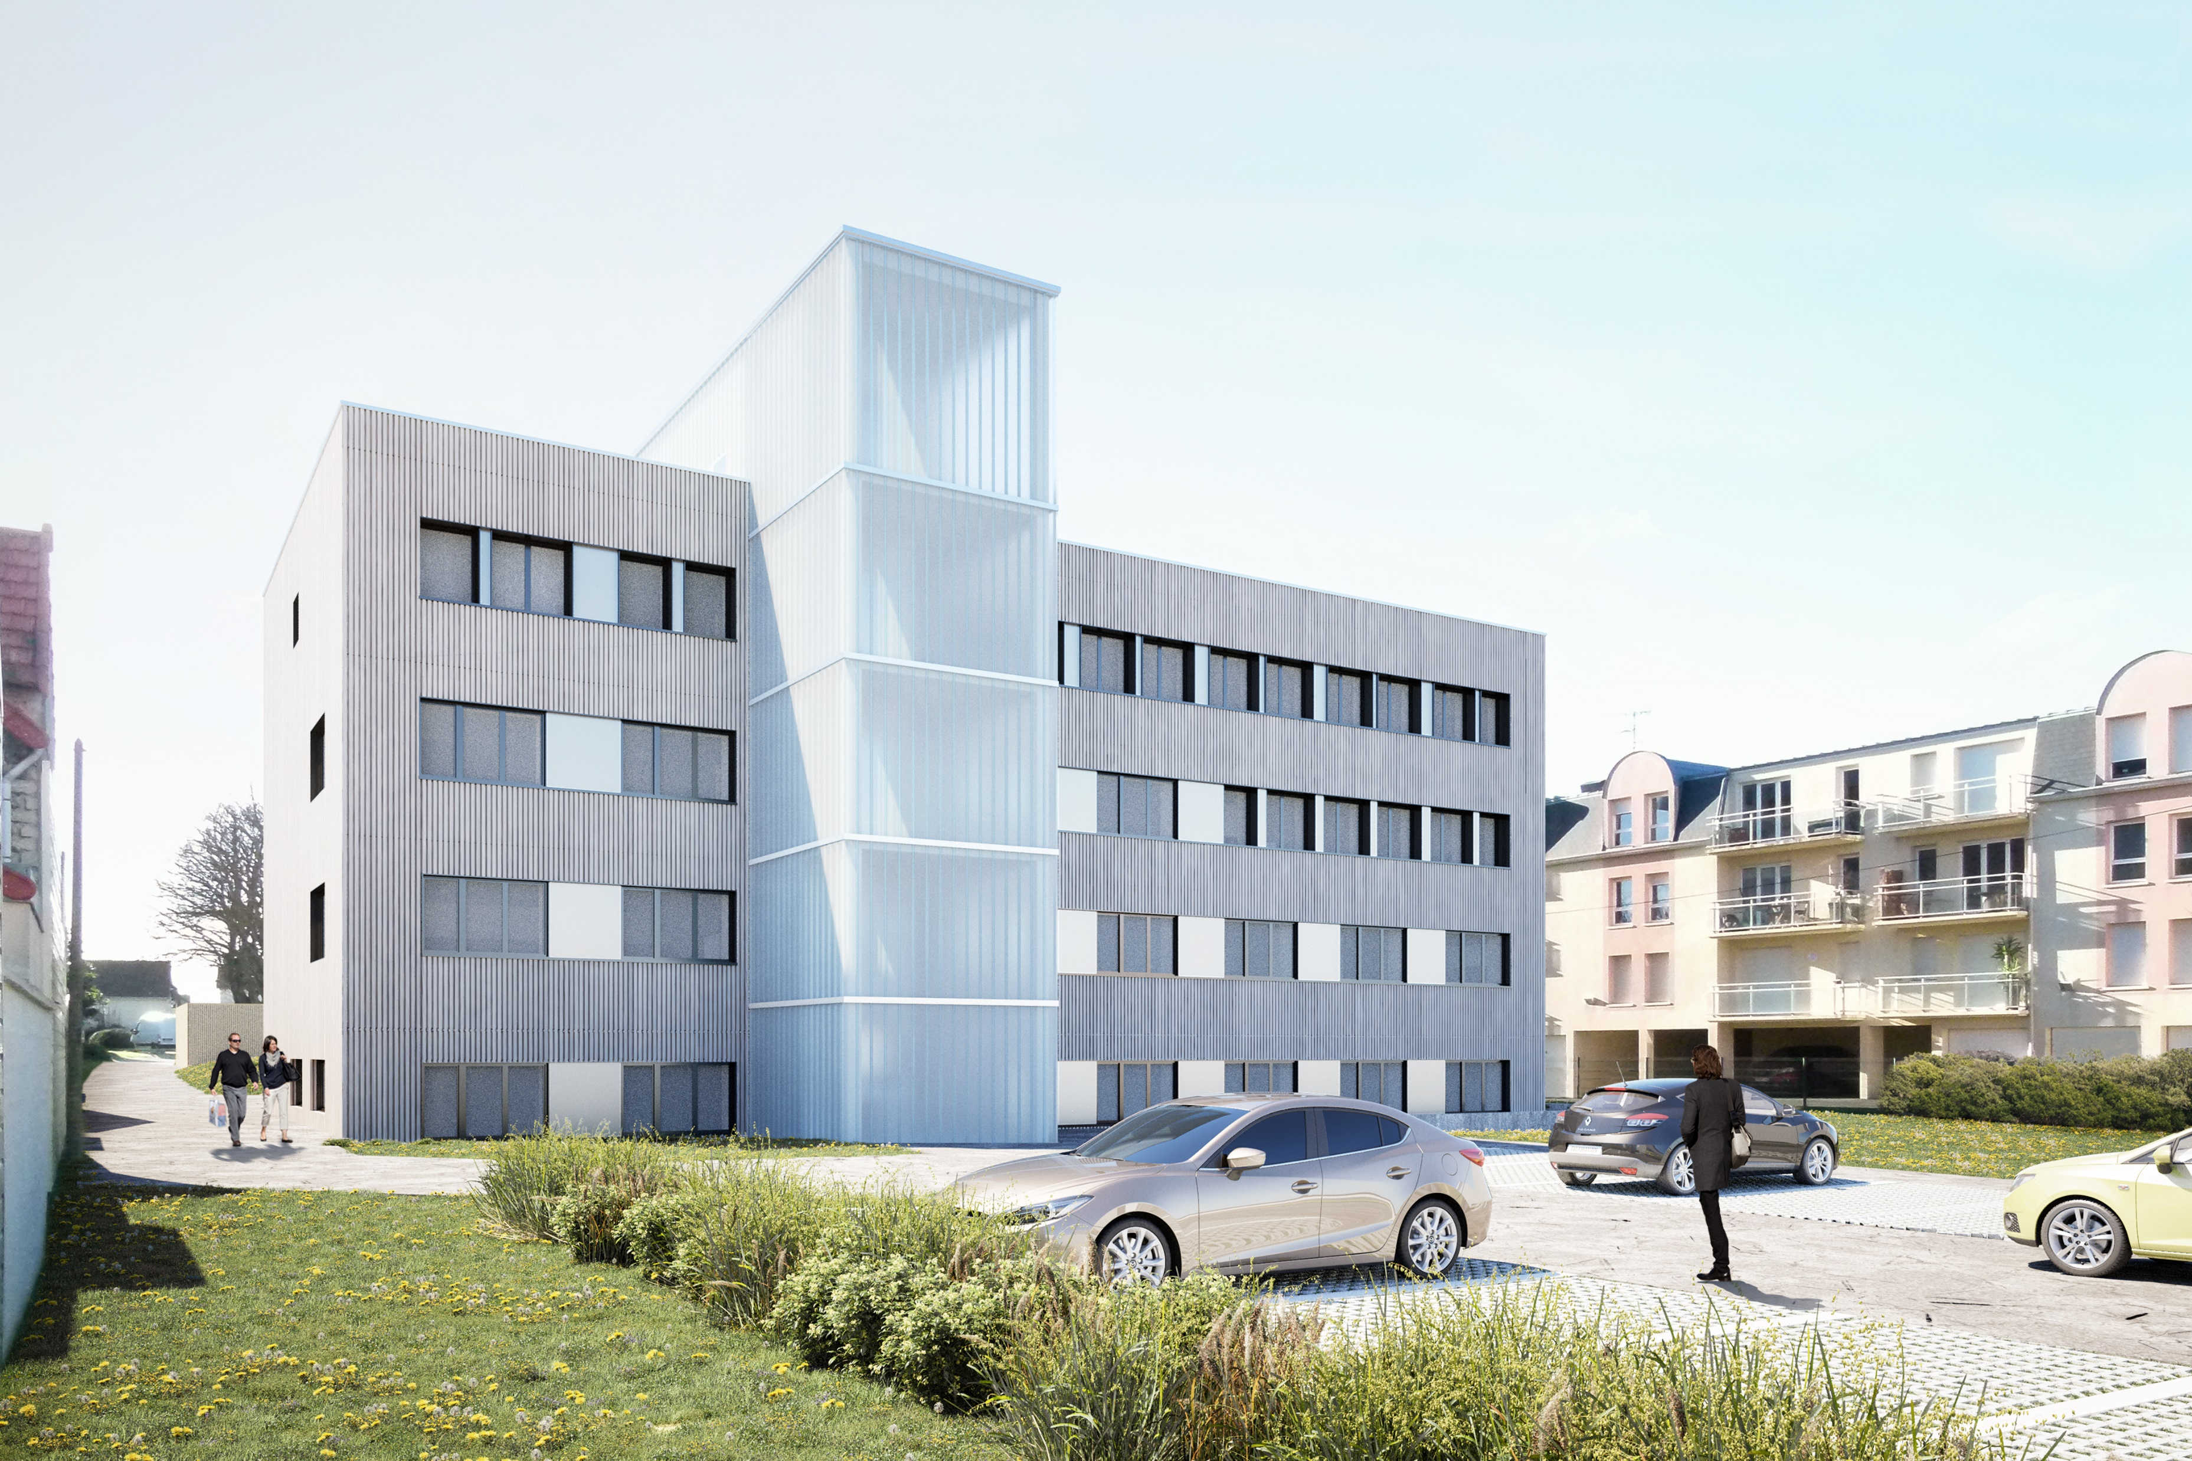
Merci!
À bientôt à Luc sur Mer!

